Slide 1

ONE WEEK
DATA SCIENCE

Slide 2

DATA WRANGLING & EXPLORATORY DATA ANALYSIS (EDA)

Slide 3
INTRODUCTION & PROJECT OVERVIEW

Slide 4
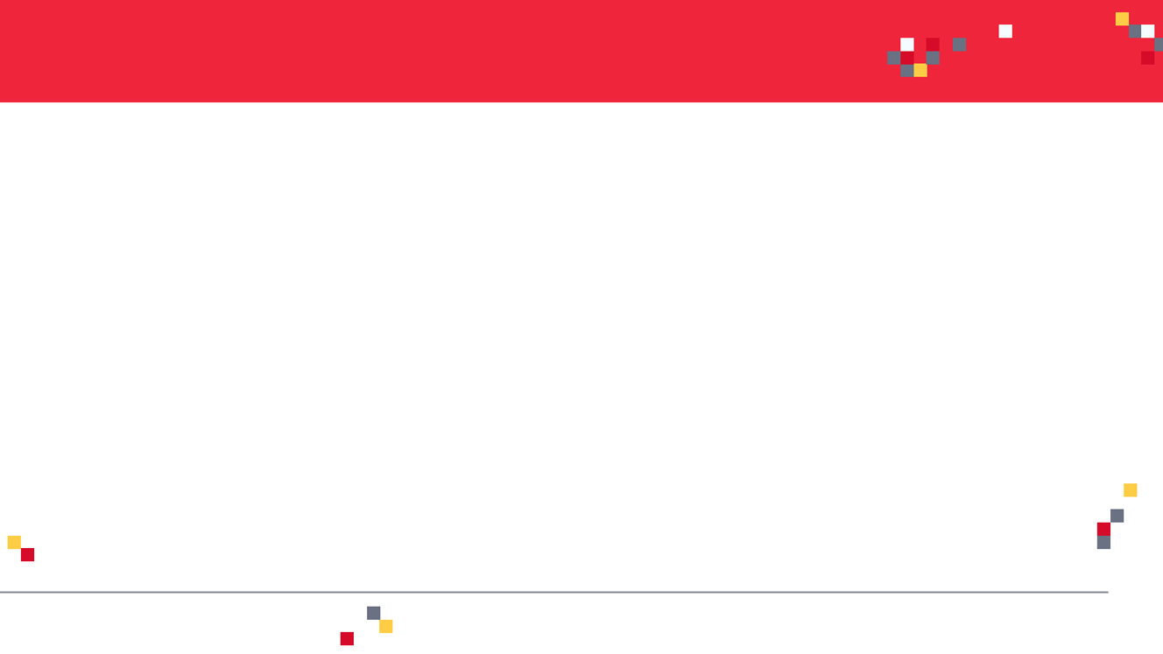
WHAT IS DATA WRANGLING?
In the real world, raw data rarely comes in a useable form.
Data wrangling is a process of transforming raw data into more useful format.
Let’s look at this data and see what’s wrong with it!
CUSTOMER ID | CUSTOMER NAME | LOCATION | CLICK ON AD?
1 | Georgina | USA | Yes
2 | Leila | Canada | 1
3 | Sarah | France | 0
4 | Bird |  | 1
5 | Max | Netherlands | 0
6 | Sarah | France | 0

Slide 5
DATA WRANGLING EXAMPLE
ENTIRE COLUMN REQUIRES ENCODING
MISSING INFORMATION
CUSTOMER ID | CUSTOMER NAME | LOCATION | CLICK ON AD?
1 | Georgina | USA | Yes
2 | Leila | Canada | 1
3 | Sarah | France | 0
4 | Bird |  | 1
5 | Max | Netherlands | 0
6 | Sarah | France | 0
REQUIRES FORMATTING
DUPLICATE ENTRY

Slide 6
KEY DATA WRANGLING TASKS
Selecting important information from raw data
Removing unnecessary information (e.x.: outliers)
Adding your own domain knowledge to improve the data
Filling in missing values
Merging several data sources into one single dataset
“Data scientists spend ~80% of their time performing data wrangling & EDA*”
Exploratory Data Analysis (EDA) is a process of analyzing data to gain valuable insights such as statistical summary & visualizations.

Slide 7

PROJECT OVERVIEW
In this project, we will analyze human resources data by performing data wrangling & EDA.
Pandas is a powerful open source data analysis tools in python.
We will learn how to:
Perform statistical analysis on real world datasets.
Deal with missing data using pandas
Perform one-hot encoding
Perform scaling including normalization and Standardization
Define a function and apply it to a Pandas DataFrame column
Perform Pandas operations and filtering
Calculate and display correlation matrix & heatmaps

Slide 8
PROJECT DEMO

Slide 9
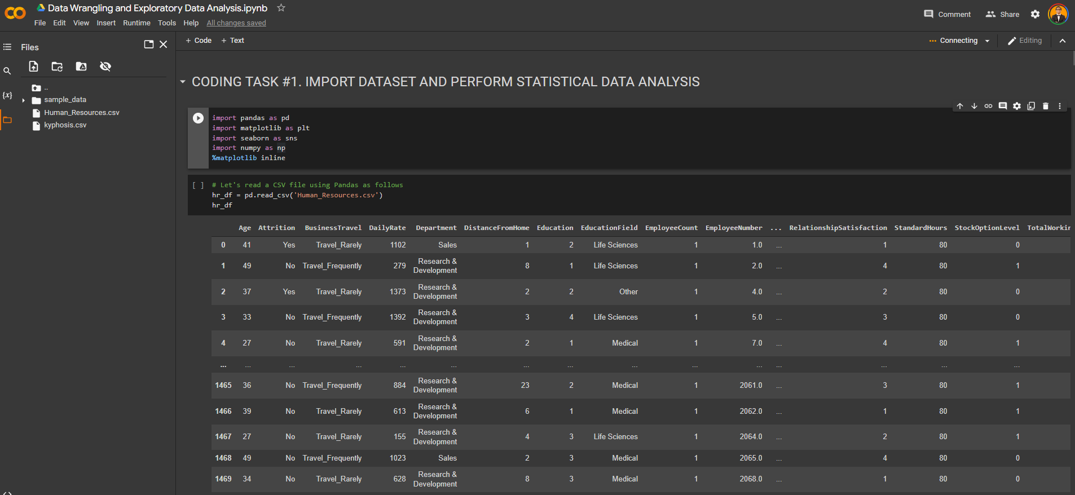
PROJECT DEMO

Slide 10
FINAL CAPSTONE PROJECT

Slide 11
FINAL CAPSTONE PROJECT TASKS
In this project, we will perform basic Exploratory Data Analysis (EDA) on Kyphosis disease Dataset.
Kyphosis is an abnormally excessive convex curvature of the spine.
Dataset contains 81 rows and 4 columns representing data on children who have had corrective spinal surgery.
INPUTS: 1. Age: in months, 2. Number: the number of vertebrae involved, 3. Start: the number of the first (topmost) vertebra operated on.
OUTPUTS: Kyphosis which represents a factor with levels absent present indicating if a kyphosis (a type of deformation) was present after the operation.
Using the “kyphosis.csv" included in the course package, write a python script to perform the following tasks:
Import the “kyphosis.csv" file using Pandas
Perform basic Exploratory Data Analysis (EDA) on the data
List the average, minimum and maximum age (in years) considered using 2 methods
Plot the correlation matrix
Convert the age column datatype from int64 to float64
Define a function that converts age from months to years
Apply function to “Age” column and add the results into a new column entitled “Age in Years”
What are the features of the oldest and youngest child in this study?
Scale raw Age column (in months) using standardization & Normalization. Perform a sanity check.

Slide 12
ONE-HOT ENCODING

Slide 13
ONE-HOT ENCODING
Can we simply replace colors with integer values?
The machine learning model will assume that:
$$GREEN>YELLOW>RED$$
COLOR
RED
RED
YELLOW
GREEN
YELLOW
ENCODED COLOR
1
1
2
3
2
WRONG!

Slide 14
ONE-HOT ENCODING
One hot encoding works by converting values such as “color” into columns with 1’s and 0’s in them.
Since data science models deal with numbers, we perform one hot encoding to convert from categorical data into numerical.
COLOR
RED
RED
YELLOW
GREEN
YELLOW
RED | YELLOW | GREEN
1 | 0 | 0
1 | 0 | 0
0 | 1 | 0
0 | 0 | 1
0 | 1 | 0

Slide 15
SCALING: NORMALIZATION & STANDARDIZATION

Slide 16
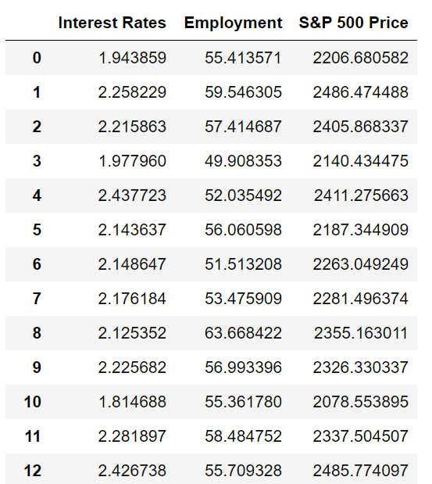
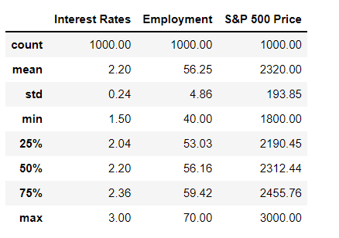
FEATURE SCALING
Feature Scaling is an important step to take prior to training of machine learning models to ensure that features are within the same scale.
Example: interest rate and employment score are at a different scale. This will result in one feature dominating the other feature.
Scikit Learn offers several tools to perform feature scaling.
RAW ORIGINAL DATASET
QUICK STATS!

Slide 17

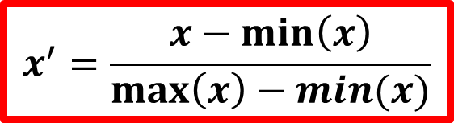
NORMALIZATION
Normalization is conducted to make feature values range from 0 to 1.
$$x^{′}=\frac{x−\min\left(x\right)}{\max\left(x\right)−min⁡(x)}$$

Slide 18
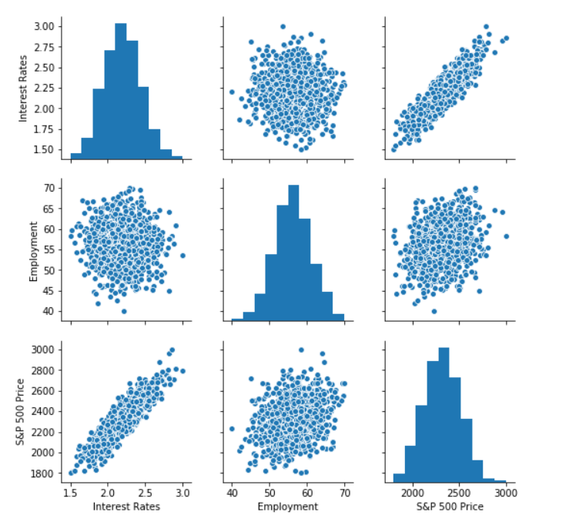
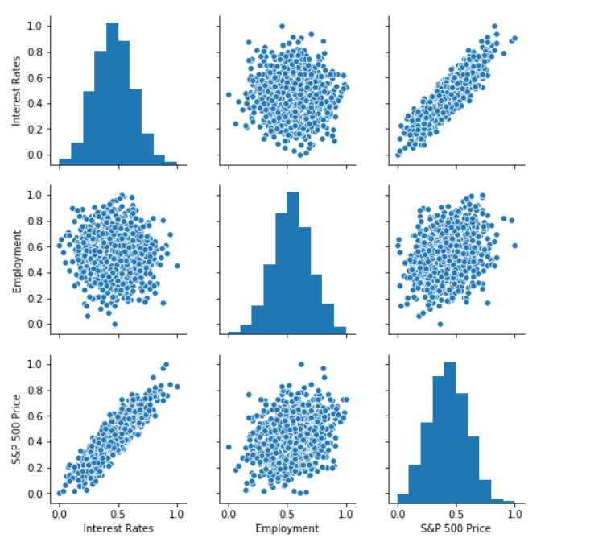
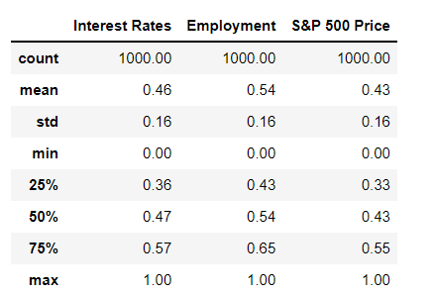
NORMALIZATION
Normalization is conducted to make feature values range from 0 to 1.

Slide 19
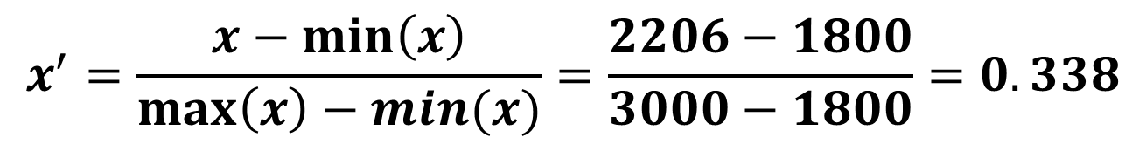
NORMALIZATION
$$x^{′}=\frac{x−\min\left(x\right)}{\max\left(x\right)−min⁡(x)}=\frac{2206−1800}{3000−1800}=0.338$$
S&P 500 PRICE (ORIGINAL)
2206
2319
3000
1800
S&P 500 PRICE (NORMALIZED)
0.338
0.432
1
0
NOTE THAT NUMBERS NOW RANGE FROM 0 TO 1 AFTER NORMALIZATION
Randomly selected Value
NORMALIZATION/
SCALING
Average
Maximum
S&P 500 PRICE (Max) = 3000
S&P 500 PRICE (Min) = 1800
Minimum

Slide 20
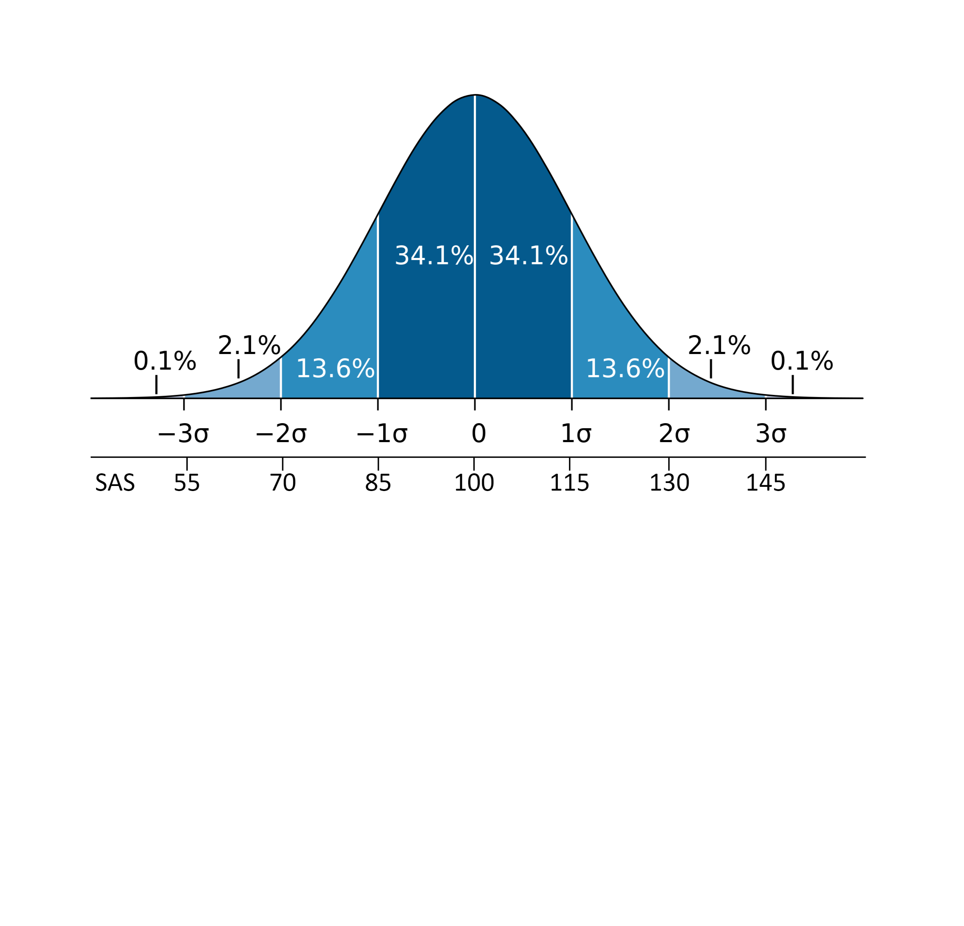


STANDARDIZATION
Standardization is conducted to transform the data to have a mean of zero and standard deviation of 1.
Standardization is also known as Z-score normalization in which properties will have the behaviour of a standard normal distribution.
$$z=\frac{x−\overline{x}}{σ}$$
Image Source: https://commons.wikimedia.org/wiki/File:Wechsler.svg

Slide 21
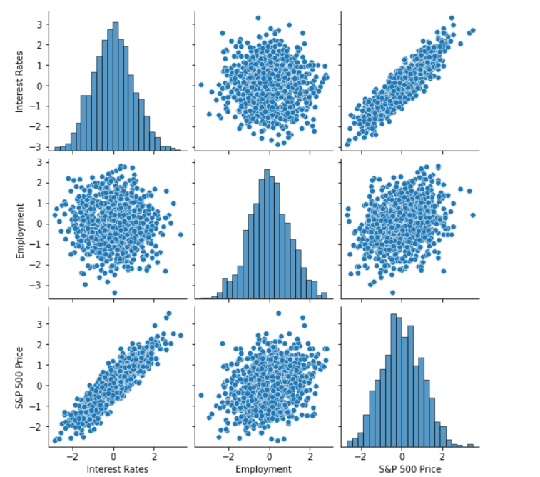
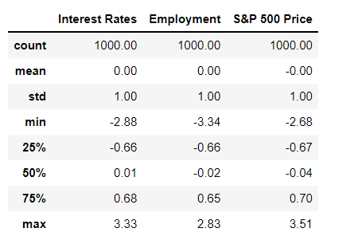
STANDARDIZATION
Standardization transforms data to have a mean of zero and standard deviation of 1.

Slide 22
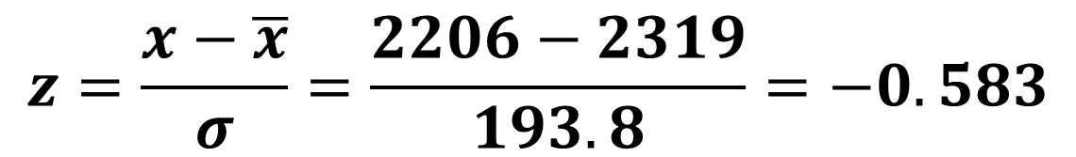
STANDARDIZATION
$$z=\frac{x−\overline{x}}{σ}=\frac{2206−2319}{193.8}=−0.583$$
NOTE THAT AFTER STANDARDIZATION THE AVERAGE IS SET TO ZERO
S&P 500 PRICE (ORIGINAL)
2206
2319
3000
1800
S&P 500 PRICE (STANDARIZED)
-0.583
0
3.513
-2.67
Randomly selected Value
STANDARIZATION
Average
Maximum
S&P 500 PRICE (Mean) = 2319
S&P 500 PRICE (Std) = 193.8
Minimum

Slide 23
ALWAYS REMEMBER!
“A normalized dataset will always range from 0 to 1”
“A standardized dataset will always have a mean of 0 and standard deviation of 1, but can have any upper and lower values”

Slide 24
PROPER QUESTIONS TO ASK?
As a data scientist, you need to answer the following questions:
Which features should I select?
Can I add my domain knowledge to use less features?
Can I come up with new features from the data I have at hand?
What should I put in the missing data locations?
It is important to choose features that are most relevant to the problem.
Adding new features that are unnecessary will increase the computational requirements needed to train the model (curse of dimensionality).
There are many techniques that could be used to reduce the number of features (compress/encode the data) such as Principal Component Analysis (PCA).

